Slide 1



Schemes of Branch Prediction
Nicolae-Andrei Vasile

Slide 2
Overview
essential to exploring the full performance of microprocessors
can increase the performance of a microprocessor by eliminating the instruction fetch stalls in the pipelines
the goal of a branch prediction scheme is to predict accurately the outcome of that conditional branch

Slide 3
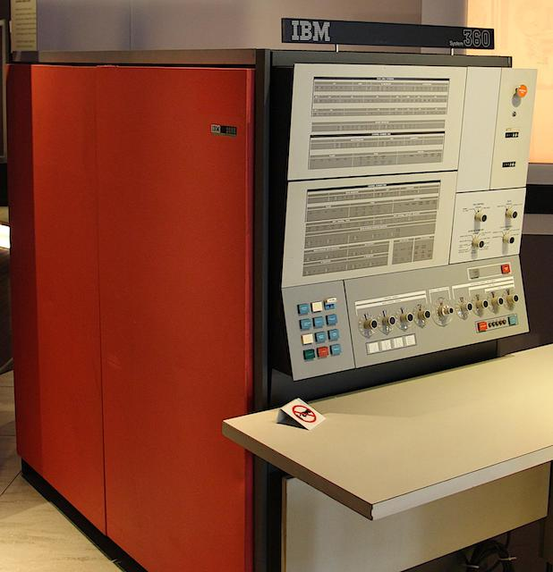
Static Strategies
Strategy 1
predict that branches are always taken/not taken
high program sensitivity can lead to widely different prediction accuracies, therefore, it must be considered
used in some of the IBM System 360/370

Slide 4
Dynamic Strategies
the likelihood of a conditional branch instruction at a particular location being taken is highly dependent on the way the same branch was decided previously
branch history can be used in several ways to make a branch prediction:
use the outcome of the most recent execution of the branch instruction
use more than one of the more recent executions to predict according to the way most of them were decided
use only the first execution of the branch instruction as a guide (less accurate than other dynamic strategies)
most straight forward strategy is to use an associative memory that contains the addresses of the n most-recent branch instructions and a bit indicating whether the branch was taken or not taken

Slide 5
Data Compression & Prediction
the basic principle of data compression is to use fewer bits to represent frequent symbols, while using more bits to represent infrequent symbols
prediction by partial matching (PPM):
is a universal compression/prediction algorithm that has been theoretically proven optimal and has been applied in data compression and prefetching
Markov predictors:
a Markov predictor of order j predicts the next bit based upon the j immediately preceding bits
the basis of the PPM algorithm of order m is a set of (m + l) Markov predictors

Slide 6
TWO-LEVEL BRANCH PREDICTION
two-level or correlation-based predictors are among the best branch prediction schemes
one or more shift-registers (branch history registers) to store history information in the first level
one or more tables of 2-bit counters (pattern history tables) in their second level
predictions are made based on the value of the 2-bit counter selected
strong similarities between two-level adaptive branch predictors and the one on Markov predictors

Slide 7
Conclusion
branch prediction strategies as well as the connection between data compression and branch prediction
different prediction strategies, such as static or dynamic, and a reasonable degree of confidence in the performance of two-level predictors.
PPM can still outperform two-level predictors when branch-target buffers are small, even though two-level predictors are close to optimal if unlimited resources are available

Slide 8


THANK YOU
Q&A

